Slide 1
Customer Churn Analysis Case Study
DATA ANALYTICS USING TABLEAU
Presented By
Indu Sehgal
Priyanka

Slide 2
Contents
What is Customer Churning?
Data Visualization
Dashboards
Findings
Insights
Recommendations

Slide 3
What is Customer Churning?
Customer Churning is the measure of how many customers stop using a product. This can be measured based on actual usage or failure to renew (when the product is sold using a subscription model). Often evaluated for a specific period of time, there can be a monthly, quarterly, or annual churn rate.

Slide 4
Data Visualization
Better understanding of the data
Learn about Customer Churning
Types of Charts
Telecom Industry Dataset

Slide 5
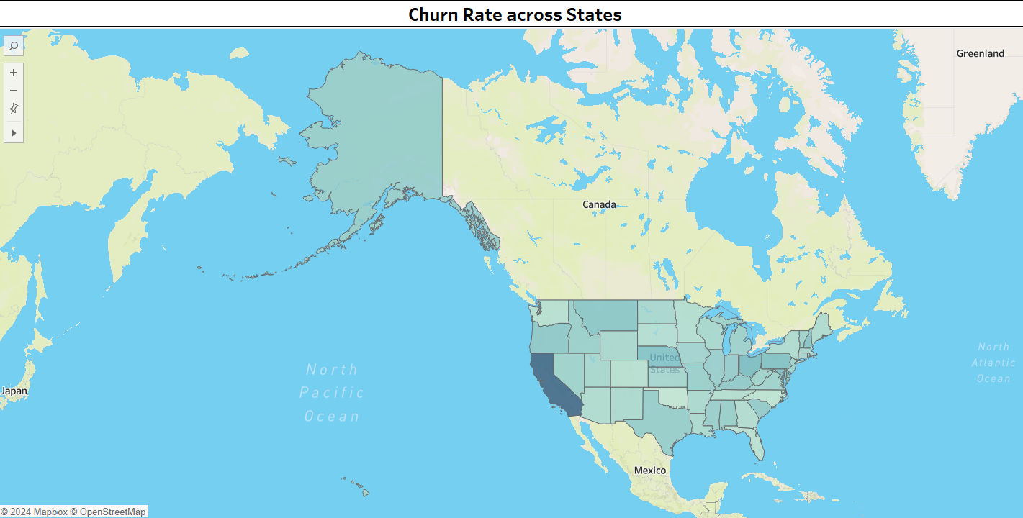
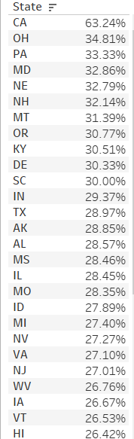
Churn Rate Across States
It Shows the churn rate across all the states.
California suffers the most churning by the rate of 63.24%.
Type of Chart : Geo Maps.
Respective calculated fields are created.
Ex : Churn Rate, Churned, etc.

Slide 6
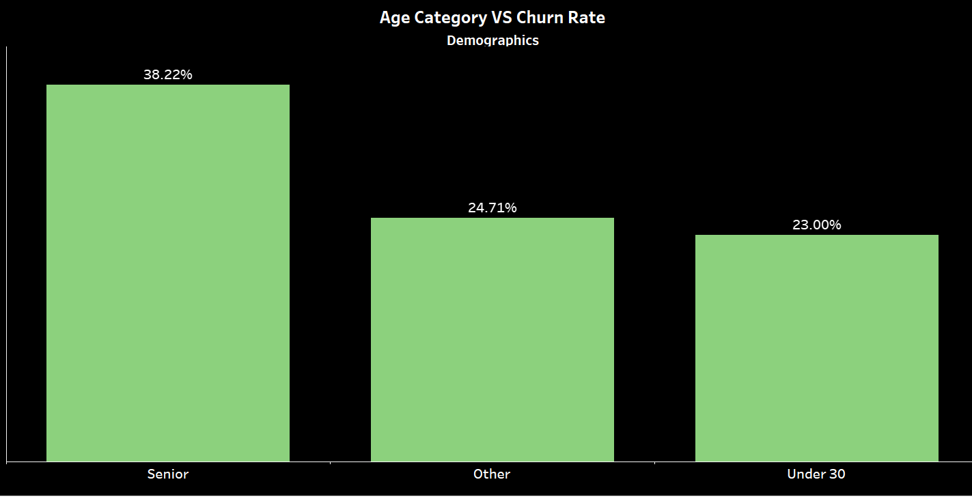
Age Category VS Churn Rate
It Shows the churn rate among different age groups.
The senior age group affects 38.22% of churn.
Type of Chart : Bar Graph.
Respective calculated fields are created.
Ex : Demographics, Churn Rate, etc.

Slide 7
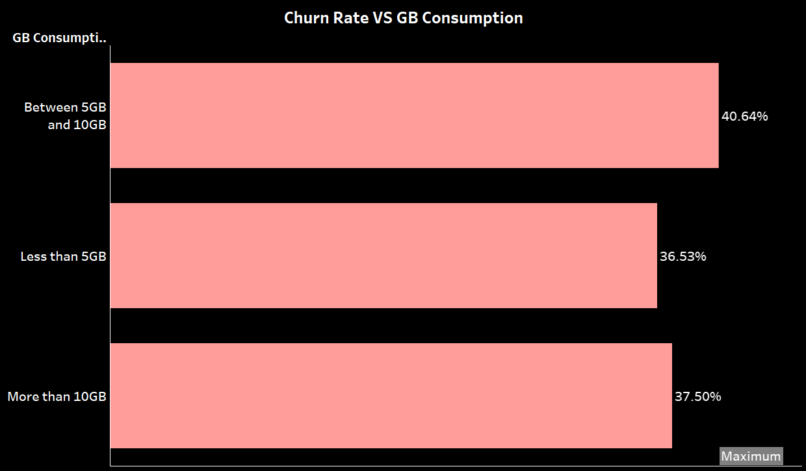
Churn Rate VS GB Consumption
It shows the churn rate according to the data consumption by the consumers.
Consumers used the data between 5GB and 10GB has the highest churn rate.
Type of Chart : Bar Graph.
Respective calculated fields are created.
Ex : GB Consumption, Churn Rate etc.

Slide 8
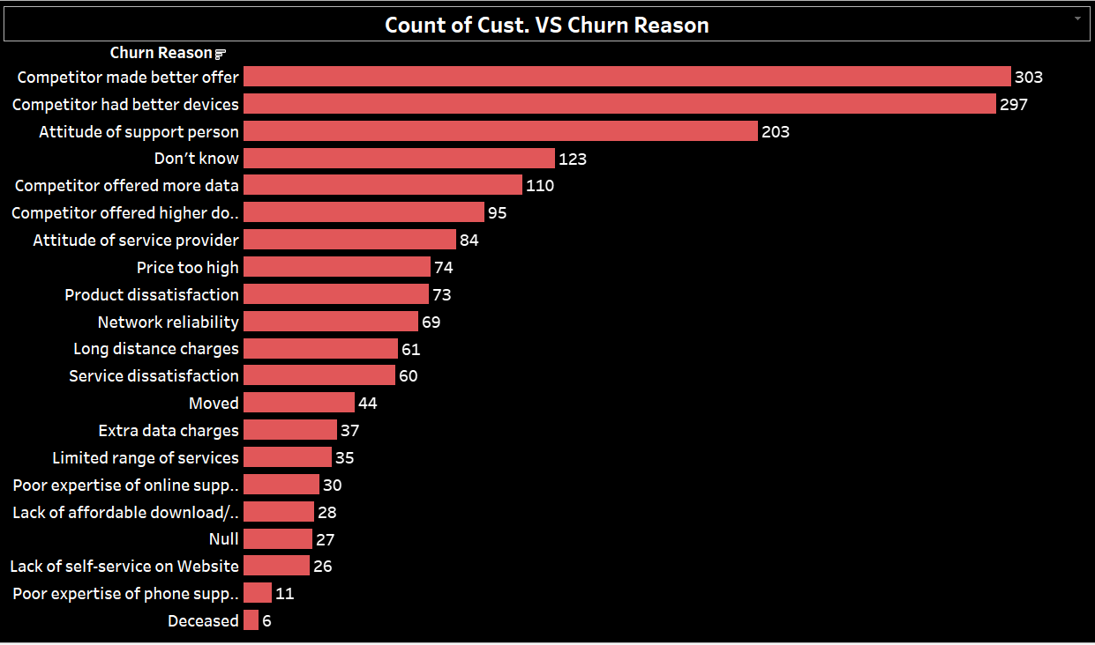
Count of customers VS Churn Reason
It shows how many people have been churned due to different reasons.
The highest count is 303 reason being, ‘The contenders made better offers to the customers’.
Type of Chart : Bar Graph.
Respective filters are applied for better analysis.

Slide 9
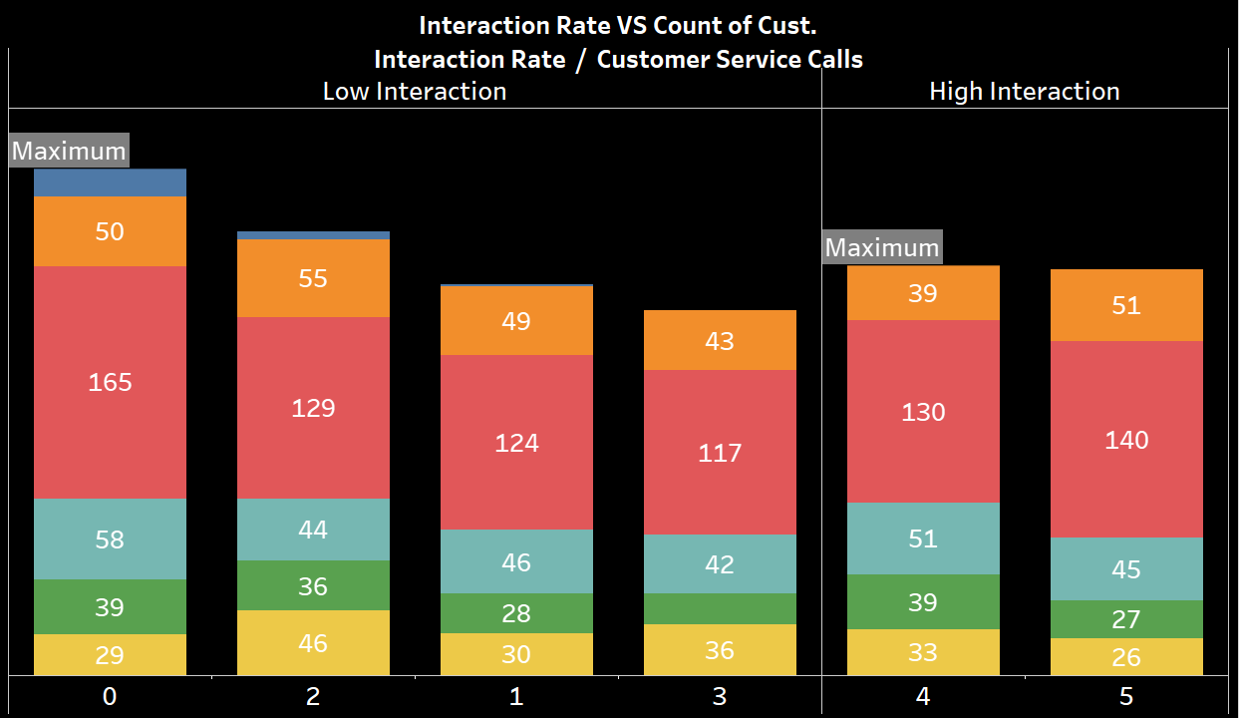
Interaction Rate VS Count of Customers
It Shows how the interaction rate of the customers affects the churning.
The users having high interaction are not satisfied with the services.
The users having low interaction are churned due to lack of interaction.
Type of Chart : Stacked Bar Graph.
‘Customer Service Calls’ field is added for deeper analysis.
Respective calculated fields are created. Ex : Interaction Rate, etc.
Respective color legend is also shown.

Slide 10
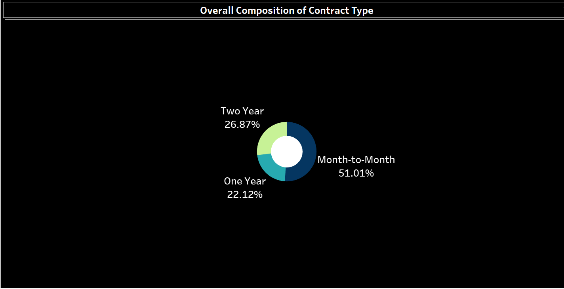
Overall Composition of Contract Type
It Shows the composition of contract types used by the customers.
‘Month-to-Month’ type leads with 51.01%.
People prefer short-term commitment with the company services.
Type of Chart : Donut Chart.

Slide 11
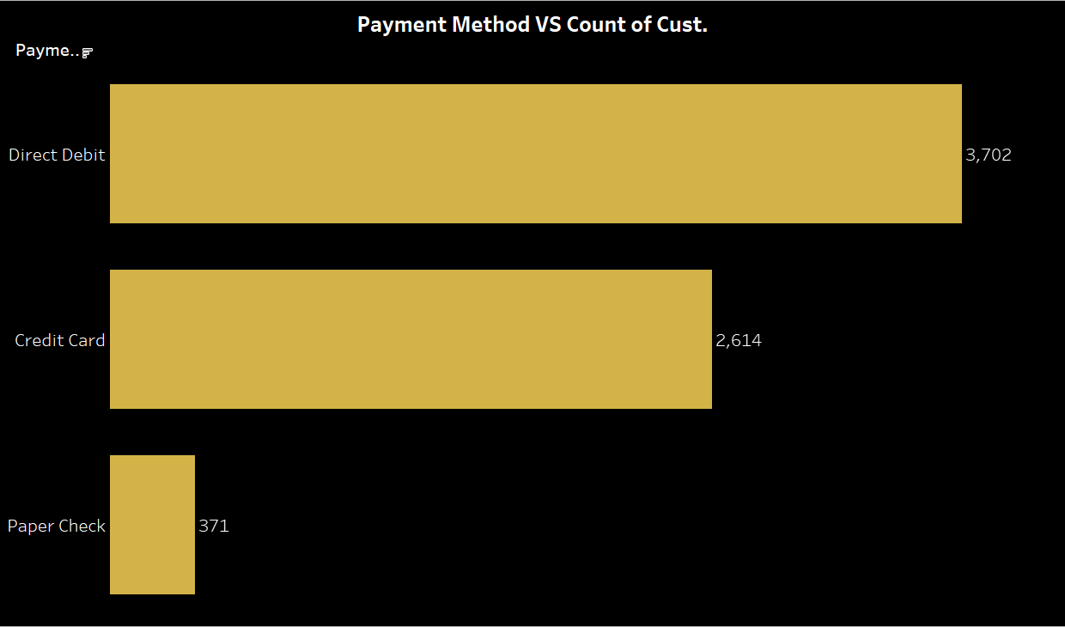
Payment Method VS Count of Customers
It Shows the various payment modes used.
3,702 customers from all age groups prefer ‘Direct Debit’
Type of Chart : Bar Chart.
Respective filters are applied for better analysis.

Slide 12
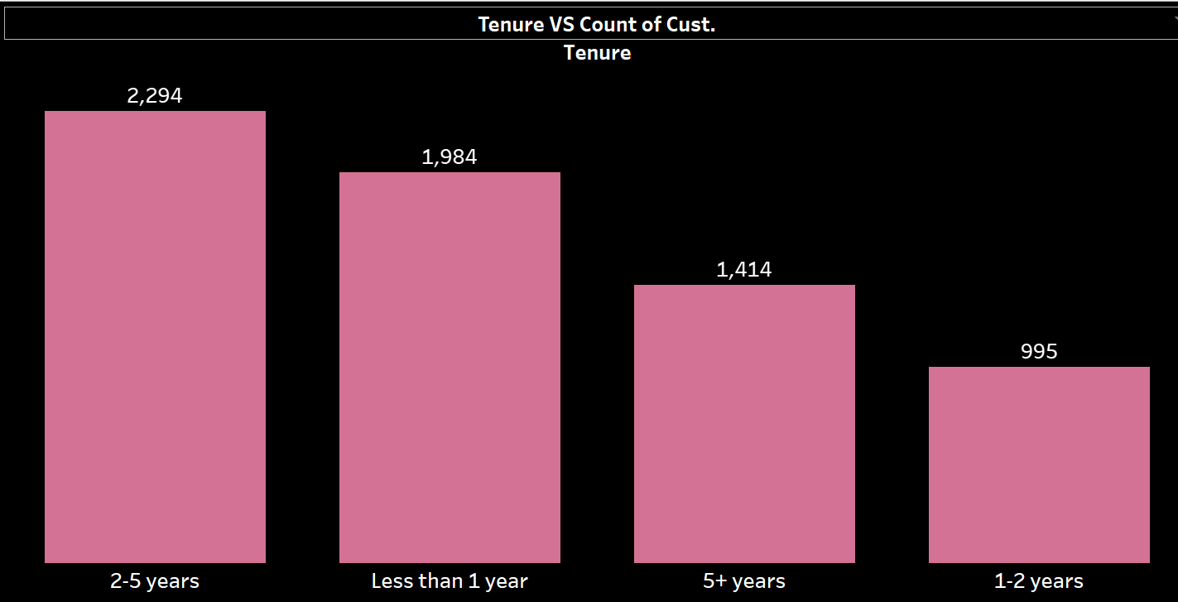
Tenure VS Count Of Customers
It Shows the count of customers w.r.t. their time of commitment.
Maximum customers have been with the company for ‘2-5’ years.
Type of Chart : Bar Graph.

Slide 13
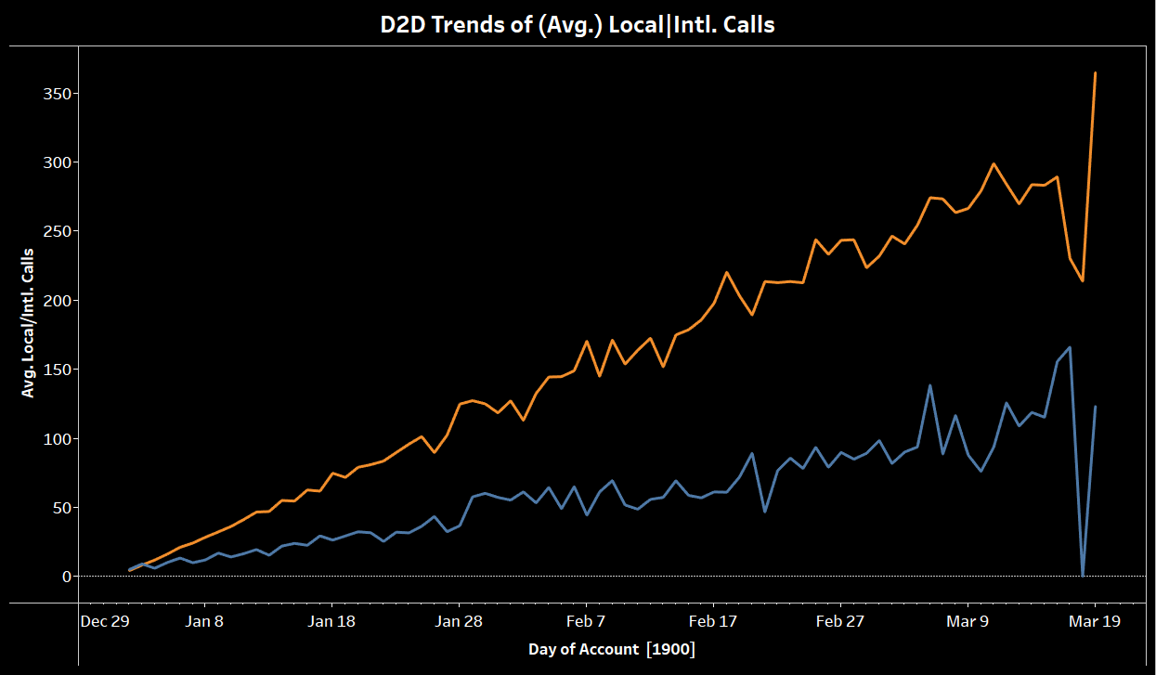
D2D Trends of Local|Intl. Mints (In Calls)
It Shows the day to day trend of local and international calls made by the customers .
The trend gets affected by churning.
Type of Chart : Line Chart
Respective filter is added for deeper analysis.

Slide 14
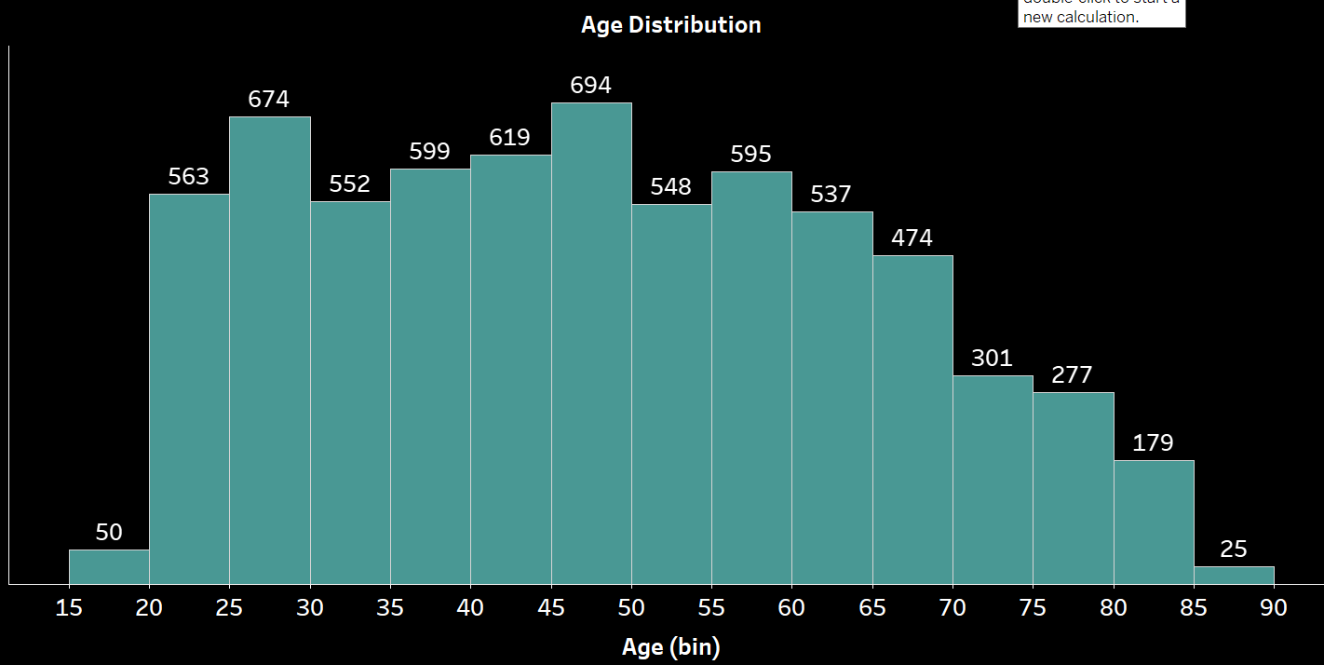
Age Distribution
It Shows the distribution of age of all the customers.
Maximum customers lie between the range of 45 - 50 years of age, followed by customers between 25 - 30 years of age.
Type of Chart : Histogram.

Slide 15
Dashboard 1 Dashboard 2 Dashboard 3

Slide 16
Findings
Overall Churn Rate is 26.86%.
The highest category responsible for churning is ‘Competitors’ by 44.82%.
California has the highest churn rate.
Senior age group alone has the churn rate of 38.22%.
Mostly customers churned by competitors generate high revenue.
Despite high or low interaction rate, customers are still getting churned.
Customers prefer short-term contracts with the company.
Maximum no. of customers have been with the company for about 2-5 years.
Trend of local/intl. calls made, gets highly affected by the churn categories.
Churning also affects the customers based on their data consumption

Slide 17
Insights
The Churn Rate indicates that the telecom industry is losing significant customers, certainly more than it is bringing in.
The most affected state needs the maximum attention.
Age of the customers is directly proportional to the churning rate.
Customers with high interaction tend to simmer because of dissatisfaction.
Customers with low interaction tend to get churned due to poor helpline services.
Users opt for monthly based plans and prefer debit mode of payment.
Customers with the highest tenure should be preserved at all costs.

Slide 18
RECOMMENDATIONS
Strategize and create targeted marketing campaigns against its contenders.
Monitor customer behavior and accordingly upskill its staff.
Should focus on customer retention and especially engage with at-risk customers.
Improve overall customer service, upgrade helpline assistance for users from all groups.
Provide better data and network plans that are reasonable, enabling long-term customer relationships.
Provide plans that acknowledge the trends of local calls, international calls, and data consumption done by the customers.
Keep a regular interaction with the customers and detailed record of their data.

Slide 19
THANK YOU

